Slide 1
How to Set Startup Program on CentOS 5.6

Slide 2
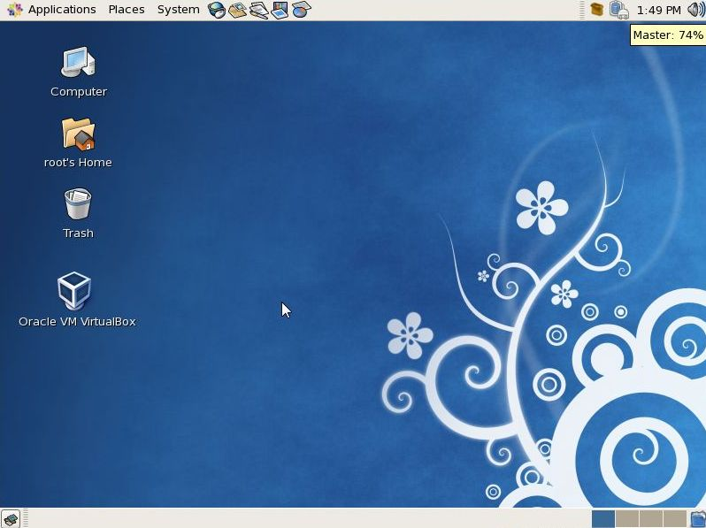
Virtual Box Run on Startup

Slide 3
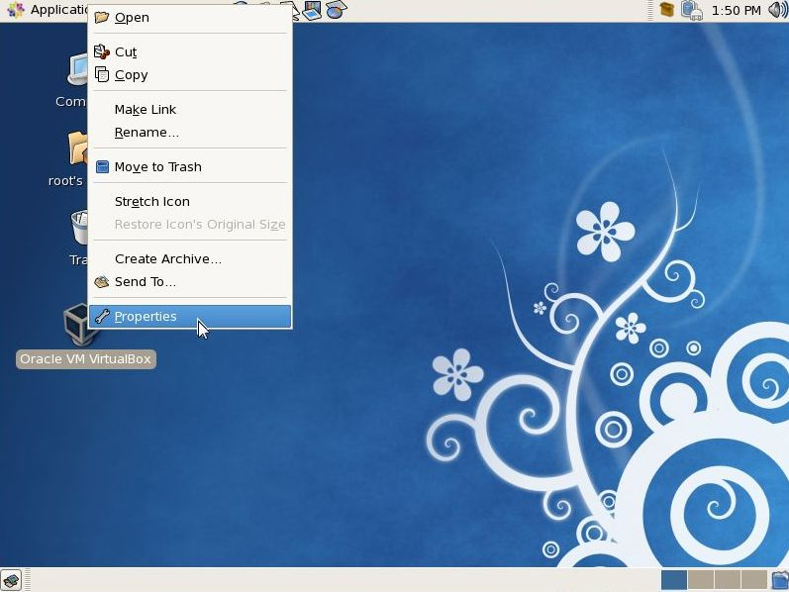

Slide 4
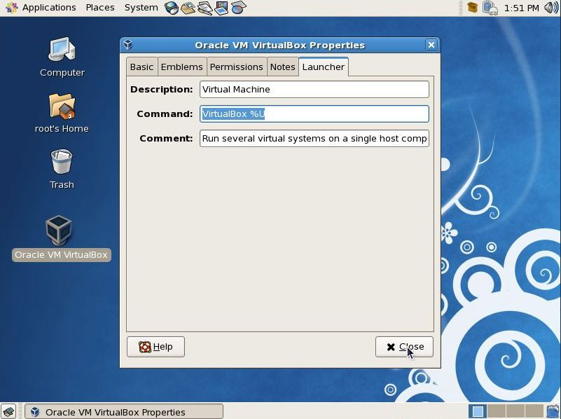
Copy this
Command

Slide 5
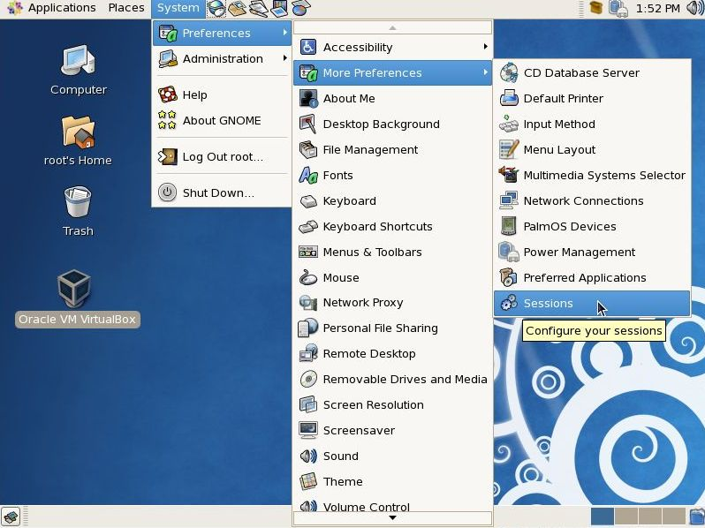

Slide 6
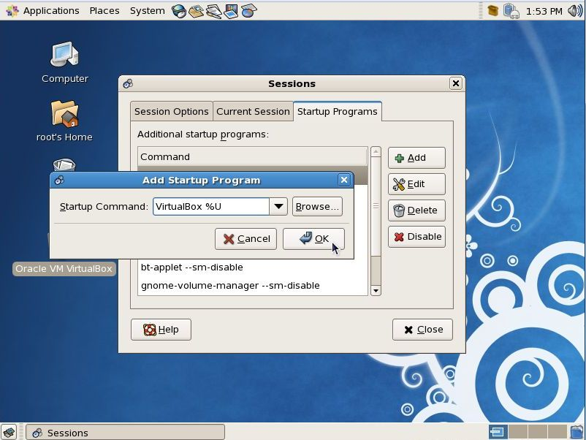
1
2
3
Paste that
command
4

Slide 7
